Slide 1
Ethics & Professional Responsibility Lightning Talk
sdmay25-26 Bryce Rega, Marek Jablonski, Gavin Patel, Jonah Frosch, Long Yu Cost-Effective and Easily Configurable High Voltage Motor Controllers for Automotive Use
November 19th, 2024
Nathan Neihart (neihart@iastate.edu), Cheng Huang (chengh@iastate.edu)
Notes:
Marek

Slide 2
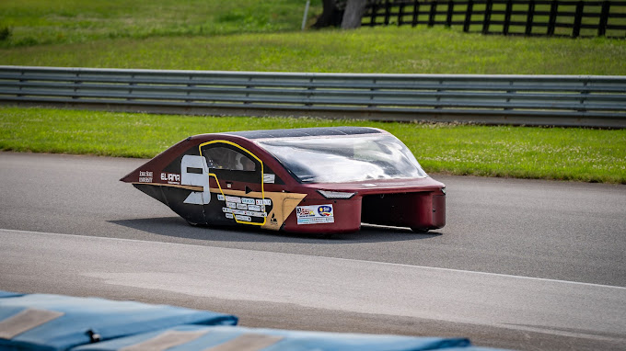
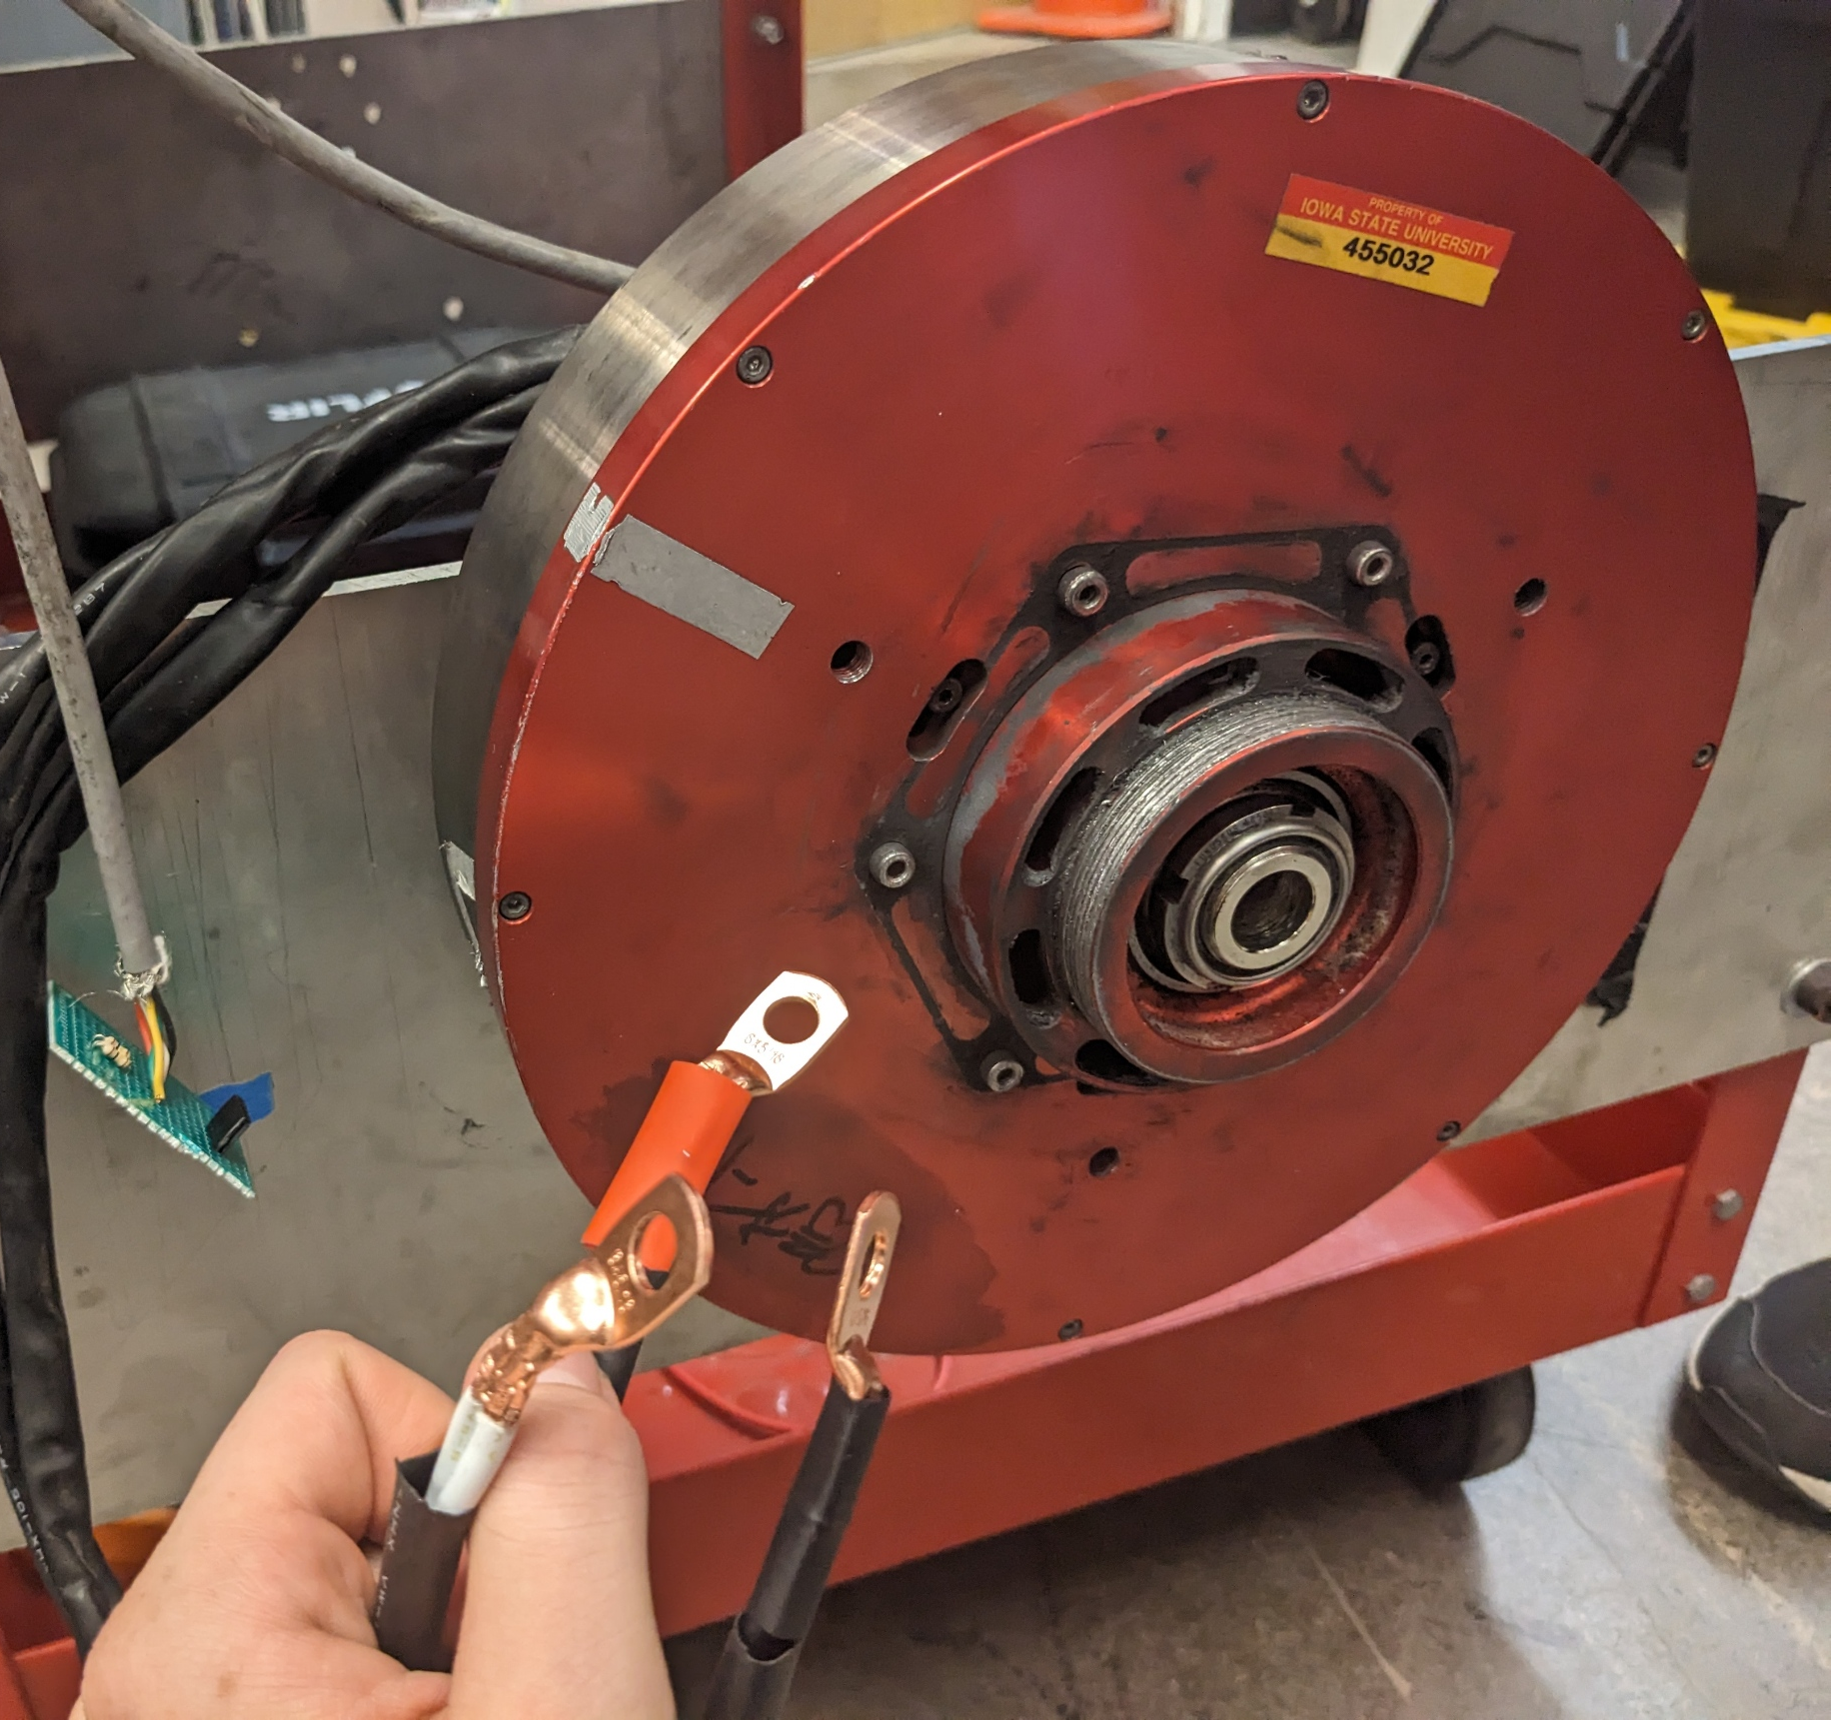
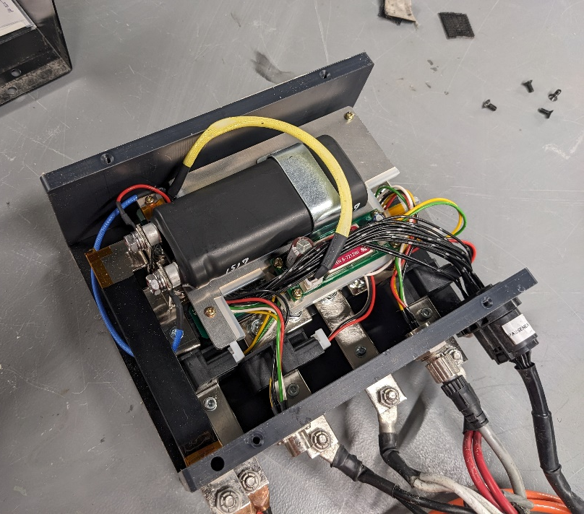
Problem Background
There exists a market gap in lightweight EV motor controllers
Used in electric bikes and collegiate solar cars
These unique applications have unique specs
Low RPM (0-1000)
High Torque (Direct Drive)
High/Medium Voltage (48-135V)
Medium Power (Peak ~7.5KW)
Problem: Existing controllers
Are very expensive (~$5k each)
Black boxes to those who use them
Notorious for having issues.
Notes:
Marek Most of our team are part of the Solar car team here at iowa state and proposed this project due to a market gap we noticed:
Motor controllers for lightweight electric vehicles
This niche of applications has very unique requirements resulting from the use a low speed direct drive motor and existing controllers are very expensive and difficult to use and debug when things go wrong

Slide 3
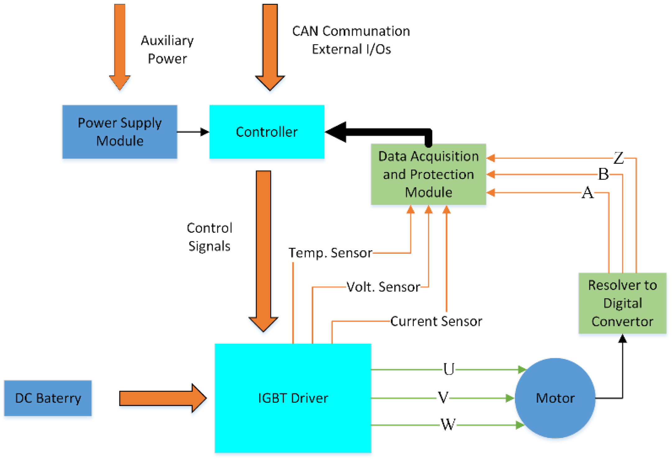
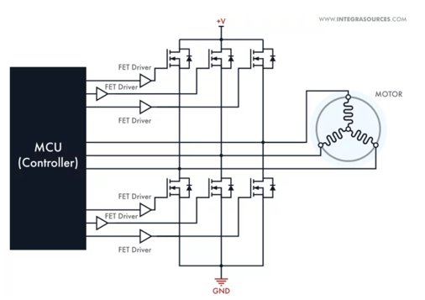
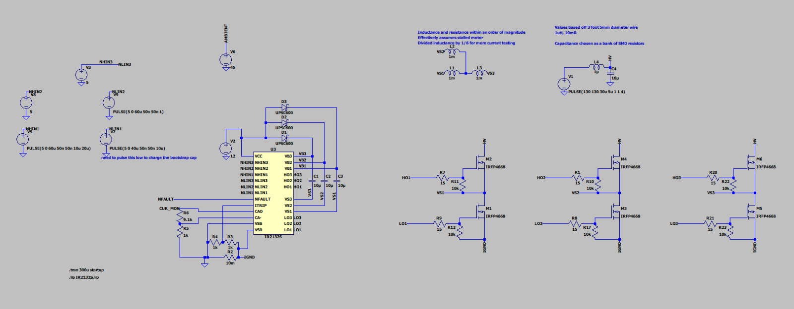
Project Overview
Custom High Voltage Motor Controller
Low total cost for controller when compared to market options
Develop a GUI for interfacing and configuring controller
Compatible with many different applications
Notes:
Marek
For this project we are building our own controller with the major aims of achieving

Slide 4
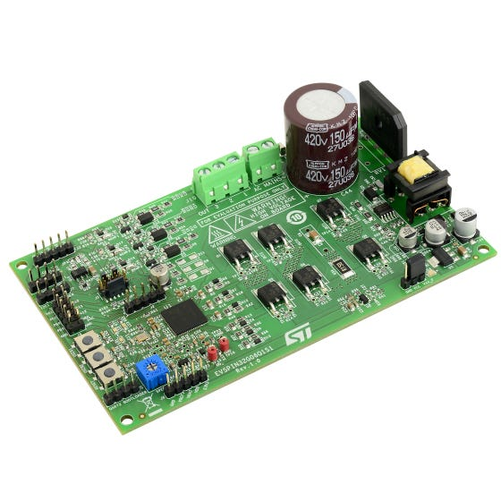
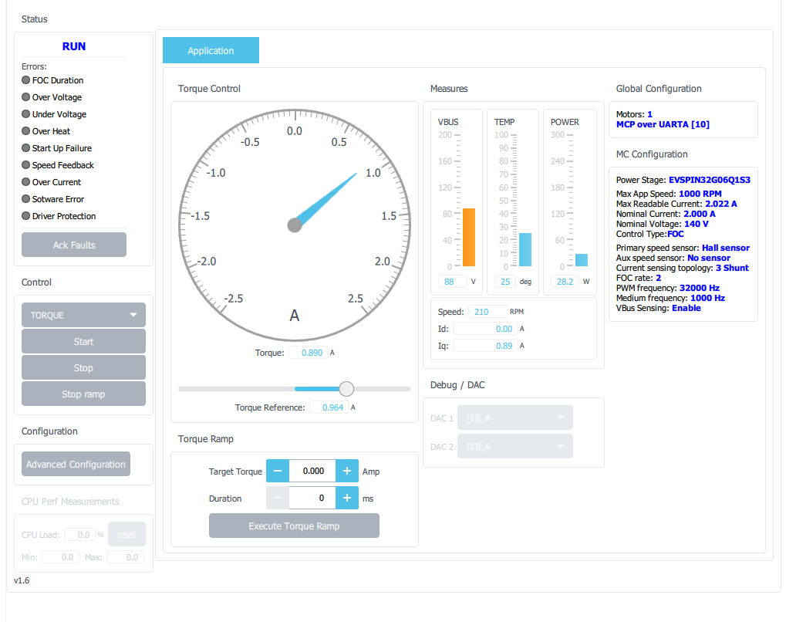
Ideal IDEALS
A strong IDEAL we have is communication honesty
Important to understanding the current state of our project, and so things don’t blow up
How this upholds responsibilities
Avoids falsifying our current work
Allows us to have honest reflections on our progress
Allows each member to have an accurate idea of future work
Our group adheres to this principle by...
Always keeping open communication with each other
Ensuring that we are honest about our understanding
Accurately explaining work to our advisors
Notes:
Gavin

Slide 5
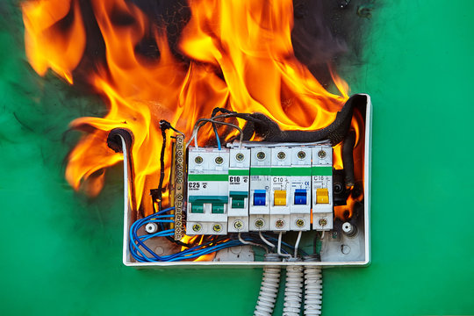
Not-Ideal IDEALS
Health, safety, and well-being is a weak IDEAL for our team
Important because of the nature of the possibility of bodily harm
Our current approach
We operate in what we as individuals consider safe conditions
We are current developing safety backups in code
How we plan to change
Develop a safety SOP for when we begin actual machine testing
Ensure that we have industry standard safety built into our software
Notes:
Gavin

Slide 6
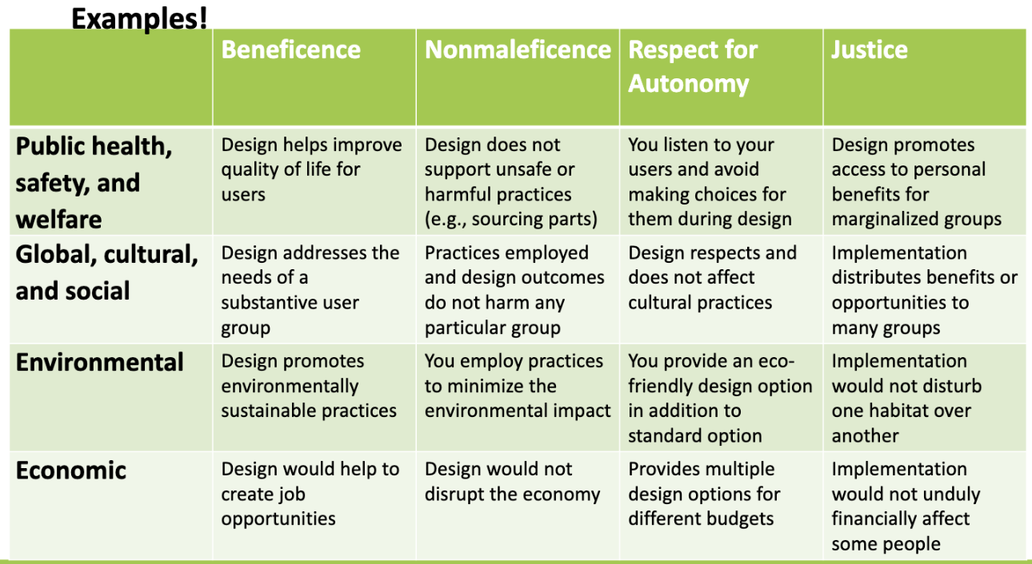
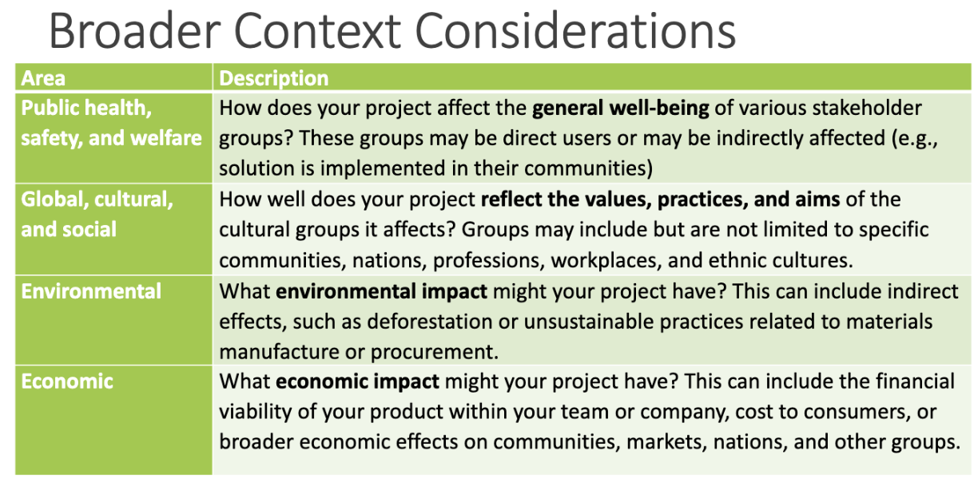
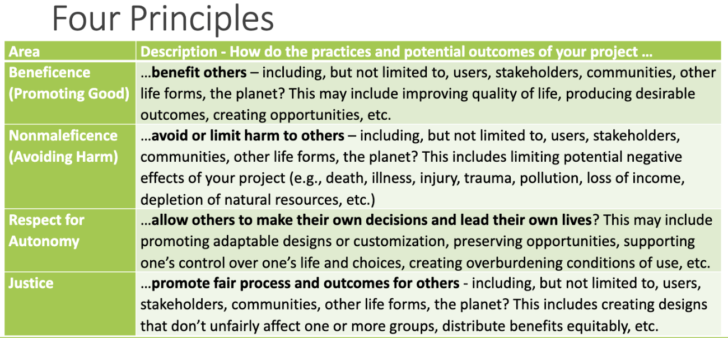
Broader Context Area
Respect for Autonomy
Trust in other team members in getting their job done builds trust
Allows team members to focus their attention solely on their own components of the project
Overall promotes a more balanced work load
Notes:
Long

Slide 7
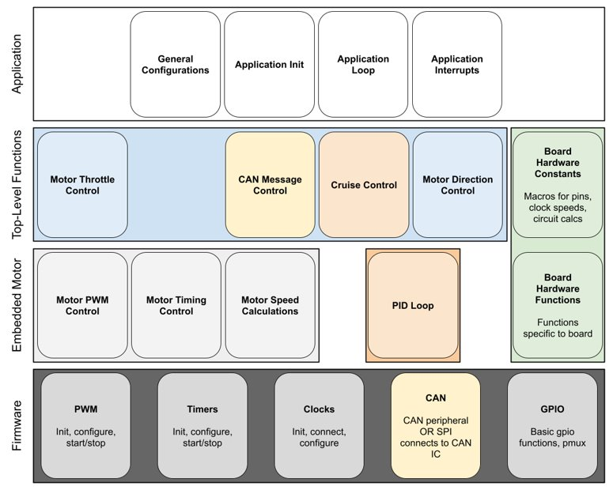
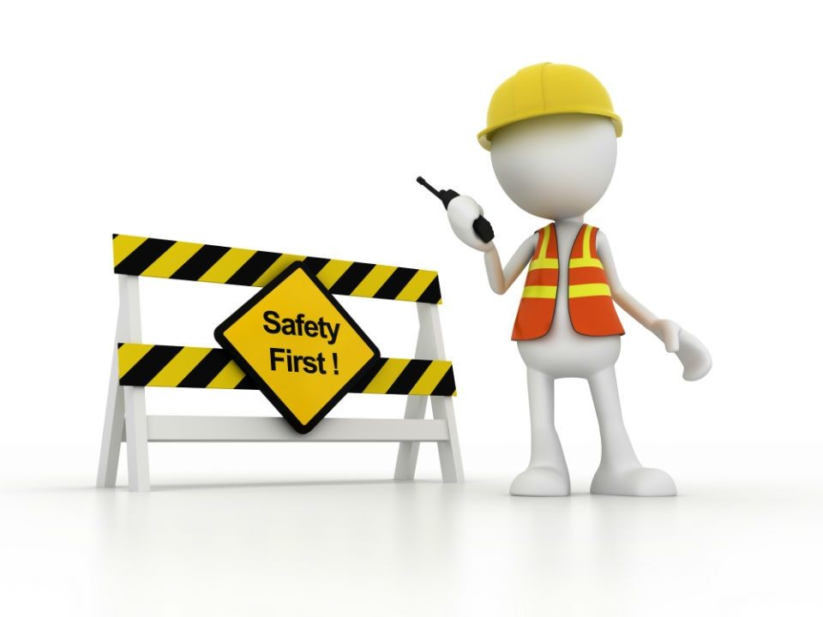
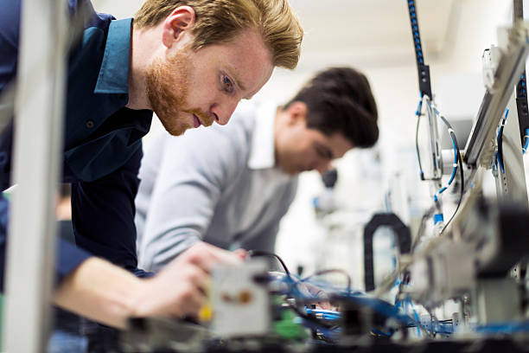
Potential Concerns
IEEE ethic I.1, "to hold paramount the safety... of the public"
Safety considerations need to be in the forefront of design
Because we are controlling various vehicle types, attention to detail is highly important
Creating risk adverse software and hardware
Adequate testing of final design to ensure safety before publishing results.
Notes:
Bryce

Slide 8
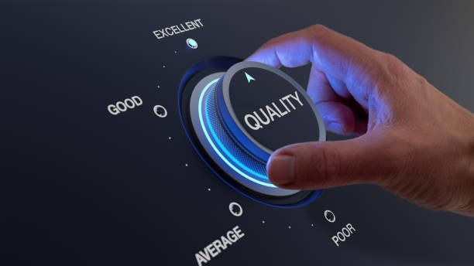
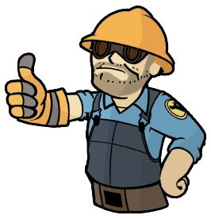
Virtue
A key virtue of our team is Commitment to quality
Delivering a high quality product is always important
Taking personal interest in the project
High self interest in project
Planning to be used for Solar Car which we have high affiliation
Required to work with our clients/group members electric bike
Wanting to leave a positive image
Work delivered leaves a lasting impression
Important to deliver quality to show engineering skills
Notes:
Bryce

Slide 9
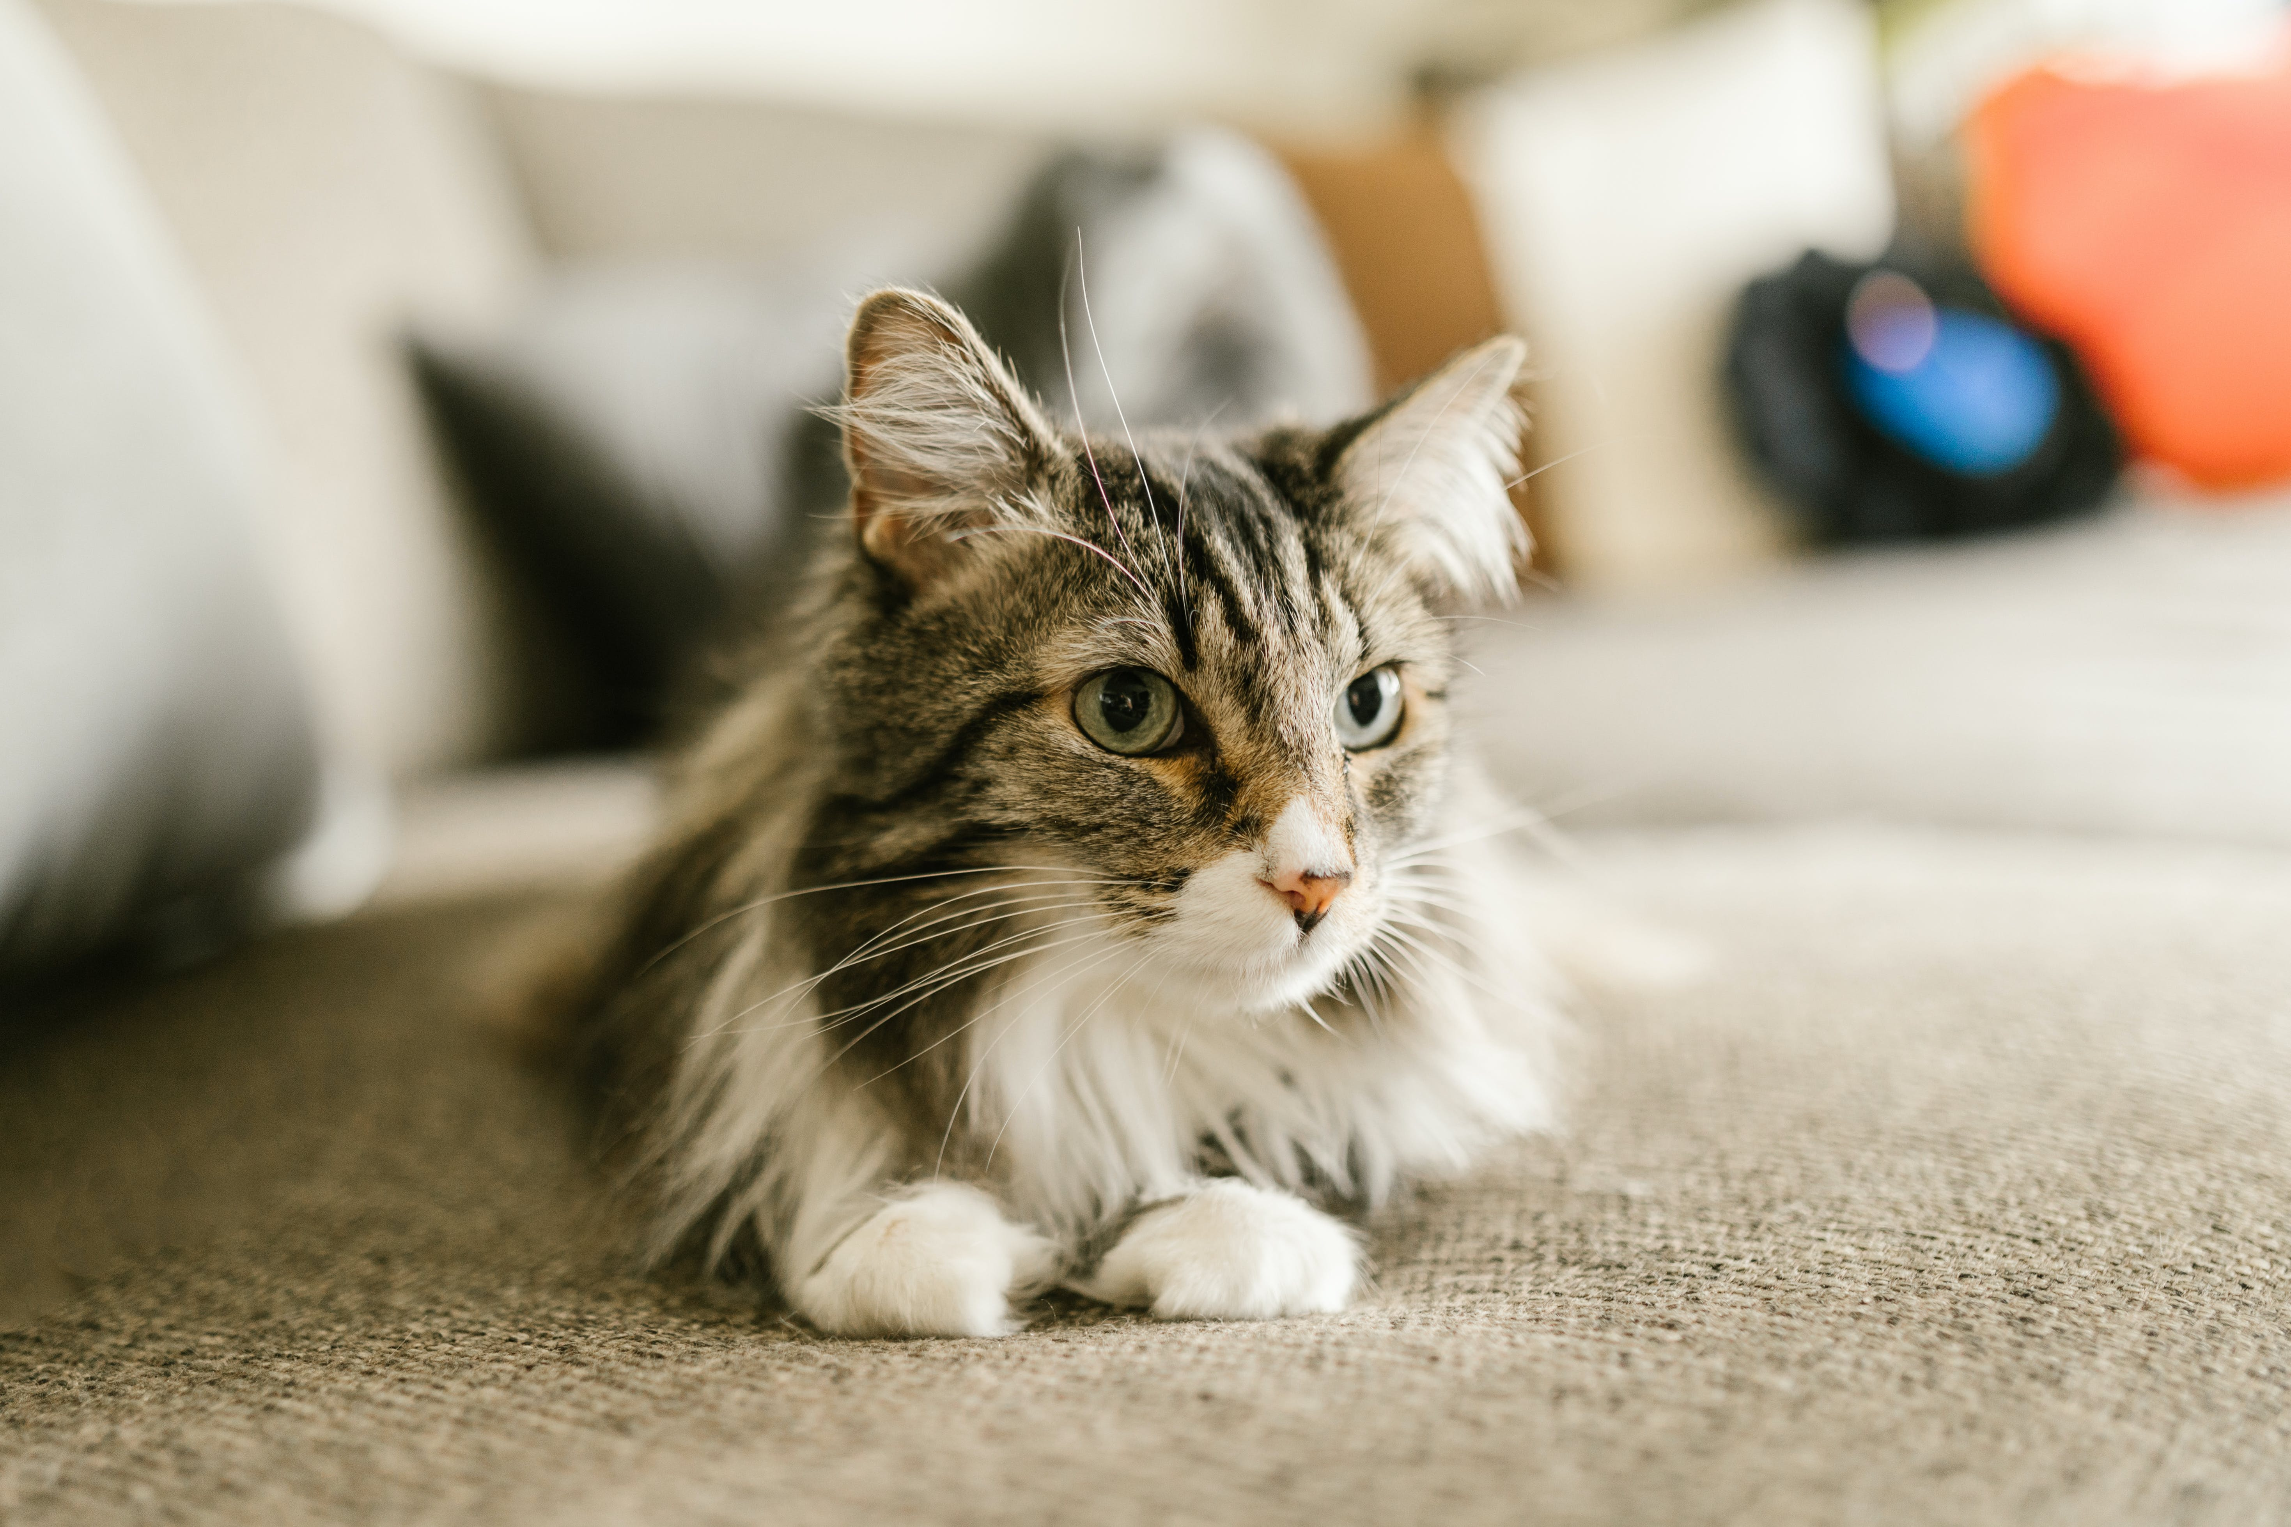
Conclusion
Ethics are an important and often underrated consideration for project design and execution. In our project context, there are many individuals' safety at risk between the drivers of a solar car, to the bikers using an electric bike, to the pedestrians who may be near our product. Making sure that we deliver a high-quality product with safety at the forefront is paramount to the success of this project as a whole.
Notes:
Bryce

